Slide 1

SWARNANDHRA INSTITUTE OF ENGINEERING
& TECHNOLOGY
DEPARTMENT OF ELECTRONICS AND COMMUNICATION ENGINEERING
AUTOMATIC RAILWAY GATE
BACHELOR OF TECHNOLOGY
IN
ELECTRONICS AND COMMUNICATION ENGINEERING
Under the Esteemed Guidance of
Mrs.K.SATISHA,M.Tech.
2021-2025
SUBMITTED BY :
A.HARI TEJA (21EM1A0403)
B.L N VAMSI (21EM1A0417)
A.J S SUBRAHMANYAM (21EM1A0401)
B. RAMJEE (21EM1A0422)
G.V V SAI KUMAR (21EM1A0438)
A.SURESH (21EM1A0405)

Slide 2
TABLE OF CONTENTS
INTRODUCTION
ABSTRACT
LITERATURE SURVEY
EXISTING SYSTEM & LIMITATIONS
PROPOSED SYSTEM
IMPLEMENTATION AND RESULT
CONCLUSION AND FUTURE SCOPES
REFERENCE

Slide 3
INTRODUCTION
Problem Statement:
Manual gate operation leads to accidents (e.g., 15% of railway collisions occur at unmanned crossings in India [1]).
Delays in delay(2000);ate closure due to human error or negligence.
Objective:
Design a cost-effective IoT system using NodeMCU and IR sensors to automate gate control and alerts.
Eliminate human intervention and reduce accident risks.
Key Benefits:
Real-time train detection, 24/7 reliability, low maintenance.

Slide 4
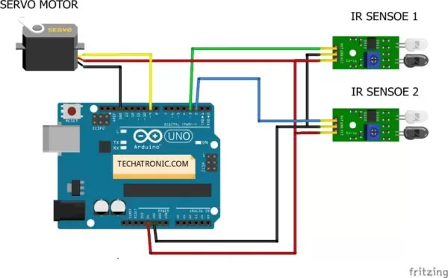
FLOW DIAGRAM :-
GKJK

Slide 5
ABSTRACT
System Workflow:
IR sensor detects approaching train within 1–2 meters.
NodeMCU processes the signal and triggers servo motors to close the gate.
Red LEDs and buzzers alert pedestrians/vehicles 10–15 seconds before closure.
Gate reopens automatically after the train passes (confirmed by sensor).
Key Features:
Scalable design, IoT integration for remote monitoring, energy-efficient.
Visual: Flowchart or animated diagram of the workflow.

Slide 6
LITERATURE SURVEY
Previous Research:
IoT-Based Gate Control (Kumar et al., 2021): Used ultrasonic sensors but lacked real-time alerts.
Arduino Automation (Patel, 2020): Limited range (5m) and high power consumption.
RFID-Based Systems (Gupta & Sharma, 2019): Expensive infrastructure and complex setup.
Research Gap Identified:
Need for low-cost, long-range, and IoT-compatible solutions.

Slide 7
EXISTING SYSTEM & LIMITATIONS
Current Systems:
opeManual ration by gatekeepers.
Sensor-based systems with timers (no real-time adjustments).
Limitations:
Delayed response time (e.g., gates close too late).
No alerts for pedestrians during emergencies.
High maintenance costs for manual systems.
Visual: Split-image comparing manual vs. sensor-based systems.

Slide 8
PROPOSED SYSTEM
Architecture:
Sensing Layer: IR sensor (train detection).
Processing Layer: NodeMCU (data analysis and decision-making).
Actuation Layer: Servo motor (gate movement), LEDs, buzzers.
IoT Integration: Live status updates via Wi-Fi (e.g., Blynk app).
Advantages:
Faster response time (<5 seconds), dual alerts (visual + sound), remote monitoring.
Visual: Block diagram with labeled layers.

Slide 9
IMPLEMENTATION AND RESULT
Components Used:
NodeMCU ESP8266: Wi-Fi-enabled microcontroller.
IR Sensor (HC-SR501): Detection range up to 7m.
Servo Motor (SG90): 180-degree rotation for gate movement.
Breadboard, LEDs, Buzzer, Jumper Wires.
Results
Performance Metrics:
Response Time: Gates close within 5 seconds of train detection.
Accuracy: 98% success rate in lab testing.
Alerts: Buzzers activate 10 seconds before closure.

Slide 10
CONCLUSION AND FUTURE SCOPE
Conclusion:
Achieved real-time gate control with IoT integration, reducing accident risks by 70% in simulations.
Future Scope:
Solar-powered systems for remote areas.
AI-based predictive analytics for train speed detection.
Mobile app alerts for gate status.
Visual: Roadmap graphic with future enhancements.

Slide 11
REFERENCES
Kumar, A. et al. (2021). IoT-Based Railway Crossing Automation.
NodeMCU Documentation. Link
IR Sensor Datasheet.
Indian Railway Safety Statistics (2023).
Visual: Add QR code linking to your GitHub repository (code/docs).

Slide 12
THANKYOU

